Slide 1

Monitoring Depth Of Anesthesia By Combining EEG And Body Vitals Using Neural Nets
Sudhanshu, Tanmai and Siddharth

Slide 2
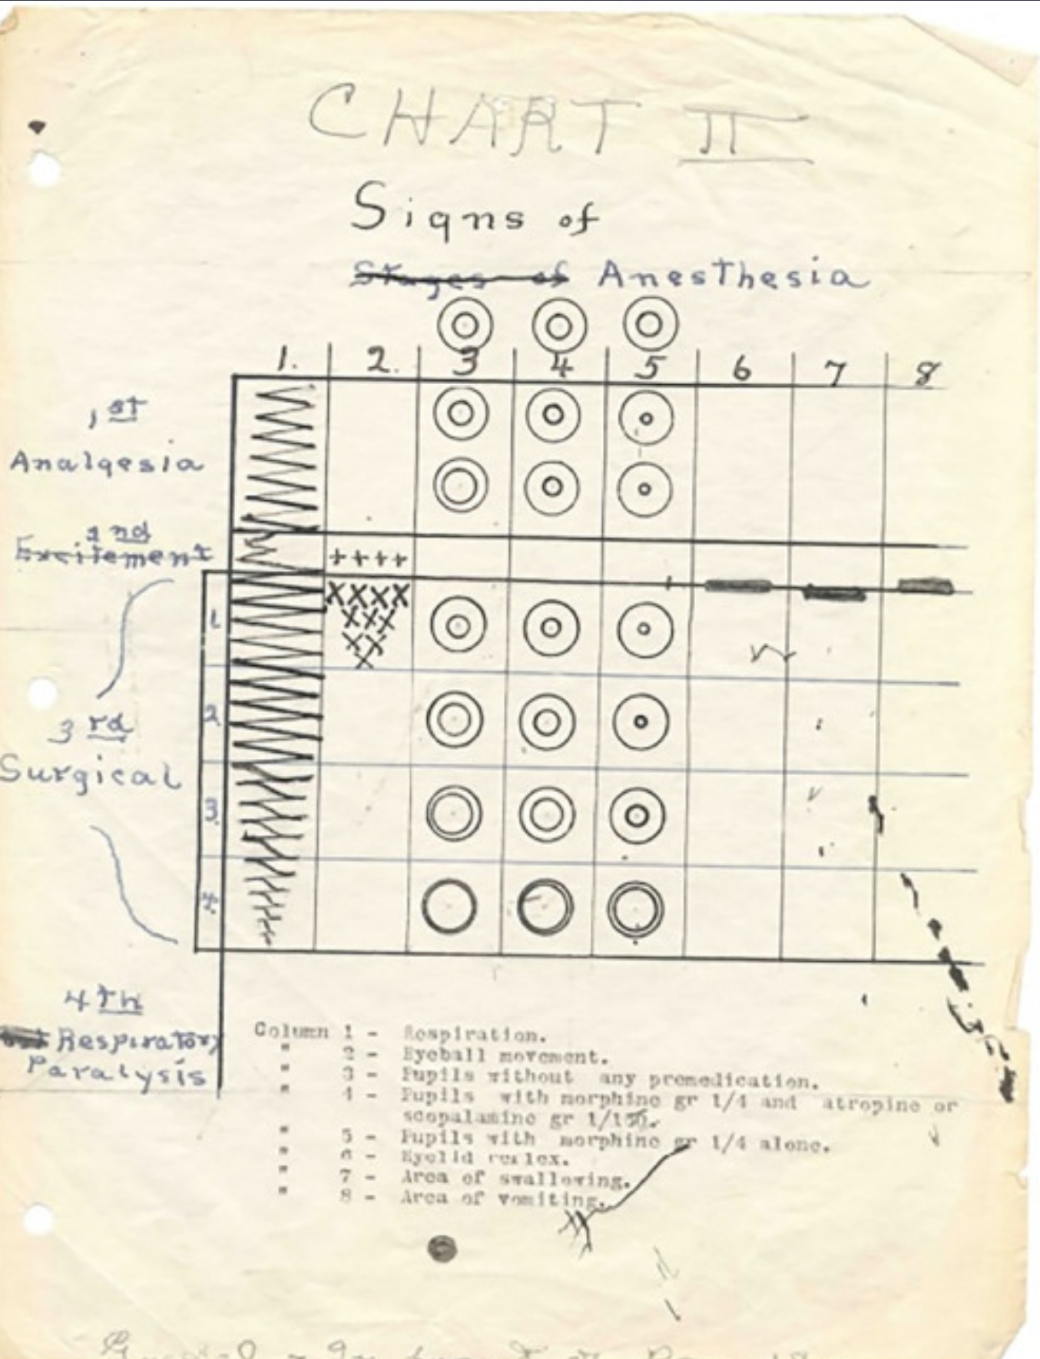
Why monitor Anaesthesia?
Since the widespread usage of anesthetics in 1850s, there has been a need to assess anesthetic depth.
Underdosage can put the patient in pain and the reflex responses of the body can interfere with the medical procedure.
Overdosage can cause a physiological 'shutdown', might be fatal.
Older ways of detection relied on pupillary reflexes and breathing rates.
Today anesthesiologists keep checks on body vitals. EEG analysis is done mainly by proprietary software like BIS.
Guedel's Classification, 1920

Slide 3
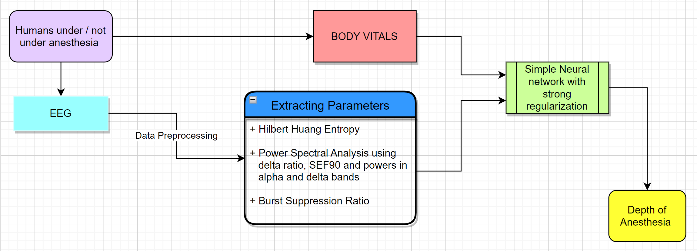
Our Approach to Monitoring Anaesthesia

Slide 4
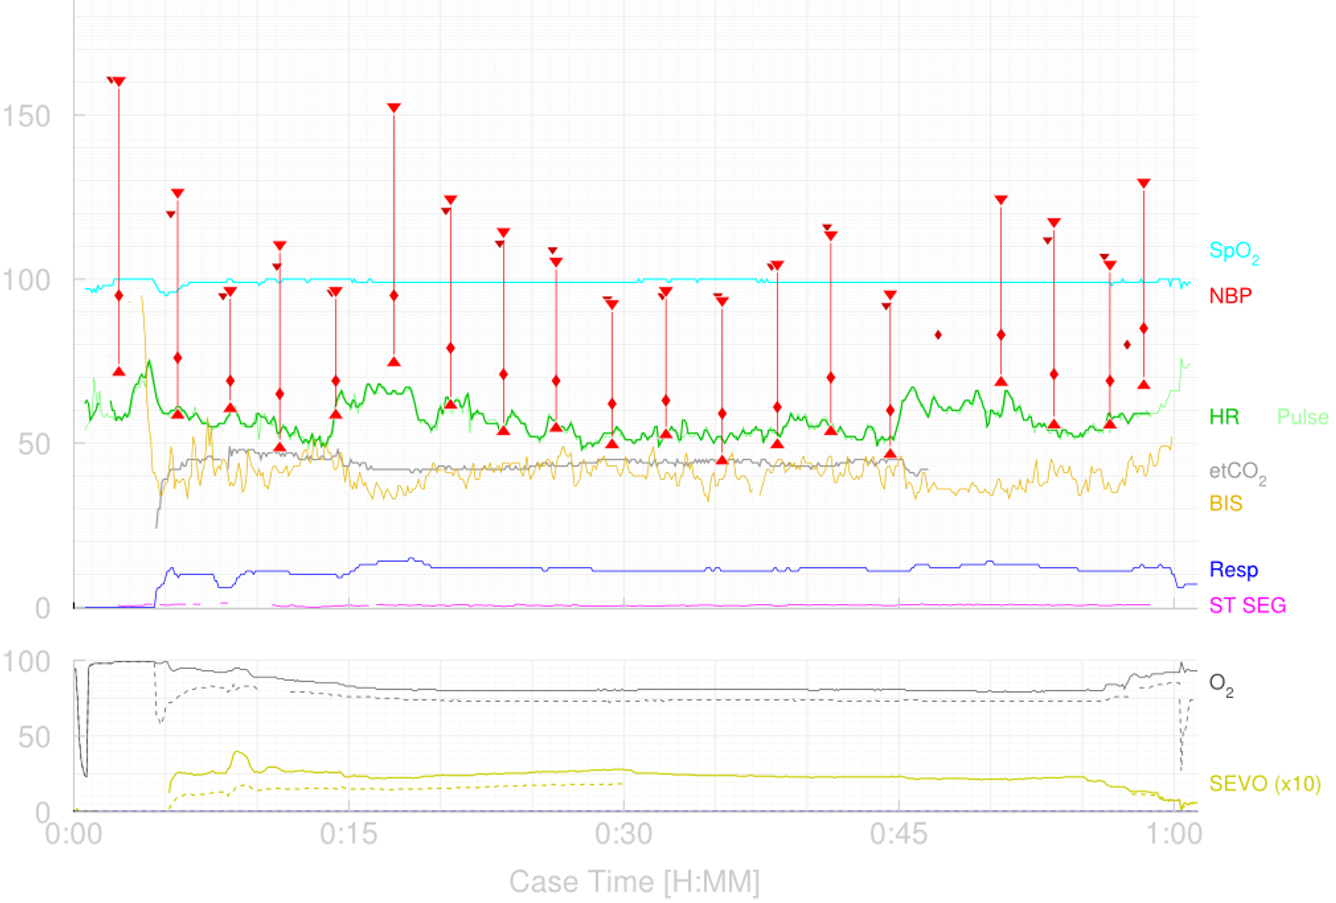
The Data
Vital signs data were recorded from patients undergoing anesthesia at the Royal Adelaide Hospital
EEG Data was only present for 4 patients – Cases 28, 29, 30 and 31
Along with EEG, we extracted the most important body vital data – Heart rate, Breathing rate and SpO₂.
Case 30 of the University of Queensland Vital Signs Dataset

Slide 5
EEG Data Preprocessing
NaN (Not a number) cells were removed from the dataset.
The data points that varied by more than 4 standard deviations ( |𝑥 − 𝜇| ≥ 4 ) were classified as outliers and eliminated.
50Hz line noise was removed using Spectral Interpolation, a technique derived from Discrete Fourier Transforms (DFT). In the frequency domain, the line noise component is extracted out and the value is set by interpolating using the coefficients of the neighboring frequencies. This technique is advantageous when compared to Notch (Butterworth), DFT and CleanLine filters.
Notes:
1) We accounted for the fact that NaN might be surrounded by NaNs
3) Talk about the advantage of spectral interpolation
DFT and CleanLine have been shown to produce spurious effects on the transformed EEG signal due to the wiping out of the entire frequency and don’t have a good performance on non-stationary line noise, whereas notch filters might cause unintended adverse filter effects that seriously change the signal and affect results12 . Notch filters and Spectral Interpolation, apart from this drawback, have been shown to have almost the same performance.

Slide 6
Extraction of Parameters
We have EEG and body vital data now. Since we want a real time processing of the data, we divide the data into epochs of 20s and then find various parameters for every 2000 points

Slide 7
Power Spectral Analysis
Absolute power in alpha band – With the increasing Depth of Anaesthesia, power in the alpha band (8 –13 Hz) is expected to decrease.
Absolute power in delta band – Concomitant with the decrease in alpha power, power in delta (0 – 4 Hz) is expected to increase.
Delta ratio – This was computed by taking the ratio of power in 0-4 Hz to the power in 8-13 Hz. With increasing delta power with DoA, the ratio of power in delta to higher frequencies is expected to go up.
Spectral Edge Frequency 90 – SEF 90 refers to the frequency in the 0-30 Hz below which 90% of the power in the range is located. This was computed by integrating over the power spectrum in the range and interpolating to 0.9 times the total power. On the same lines as the previous arguments, SEF 90 is expected to decrease with increasing DoA. Schwender et al. (1996) reported the SEF 90 value to decrease to 12-14 Hz under surgical anaesthesia from 18-20 Hz baseline.

Slide 8
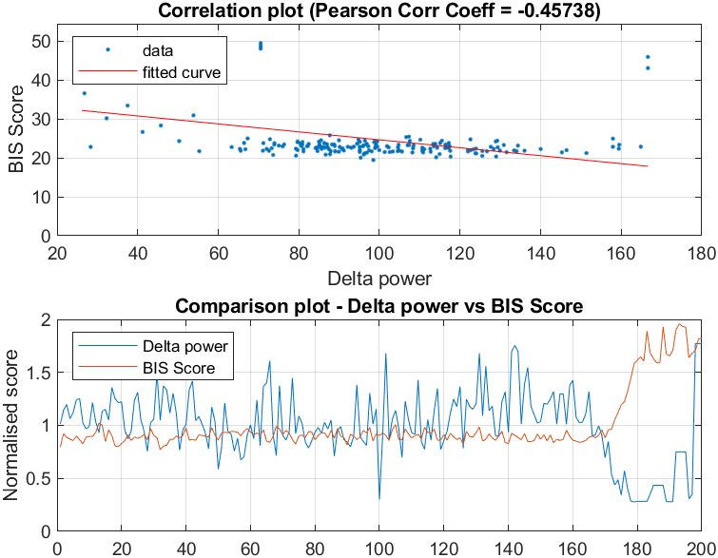
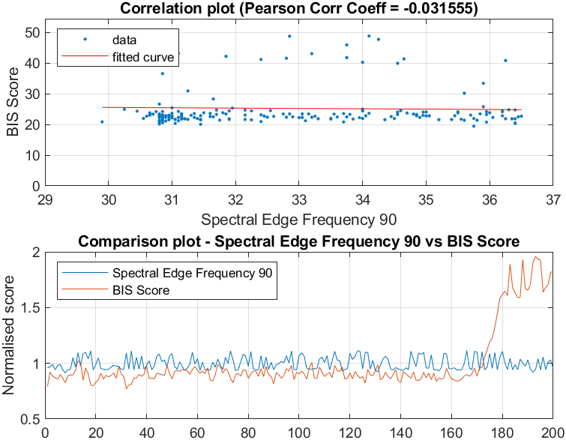
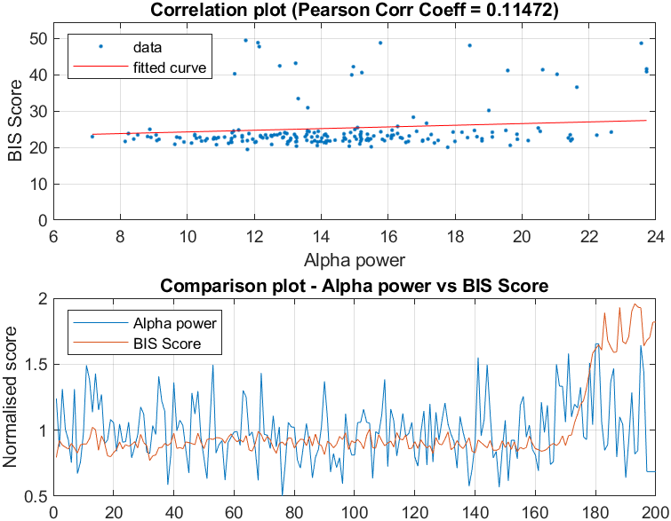
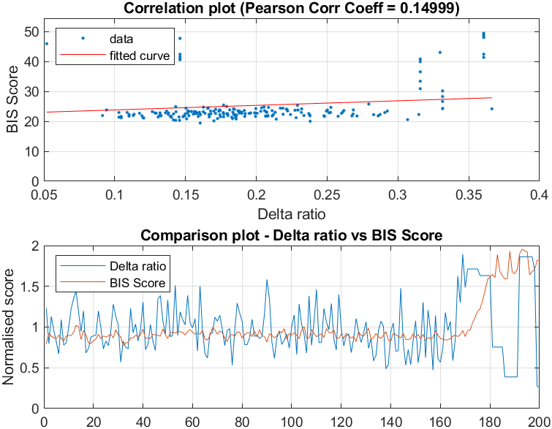
Results

Slide 9
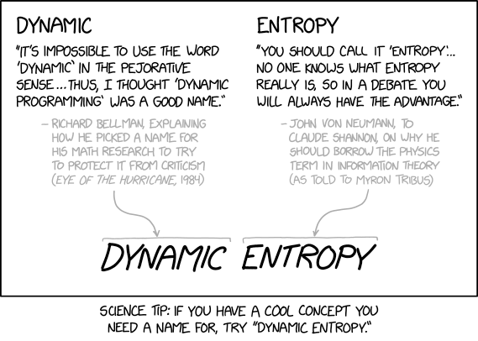
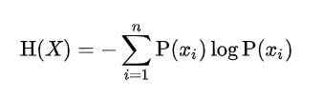
Hilbert Huang Entropy
Why Entropy?
Informational Entropy sort of captures how much information/surprisal is there in the signal. A more Random signal his higher Entropy. As a person goes deeper into anesthesia, there is lesser activity in the brain, and the activity becomes more “predictable”. Therefore, the entropy decreases.
Since EEG signal are not always LTI, non-linear methods might sometimes lead to better results
Simple Shannon entropy doesn’t really give a lot of information as it varies a lot from person to person. Therefore, spectral entropy is a better measure. Hilbert Huang transform is a better method to breakdown functions into basis functions, as it does not assume a certain form.

Slide 10
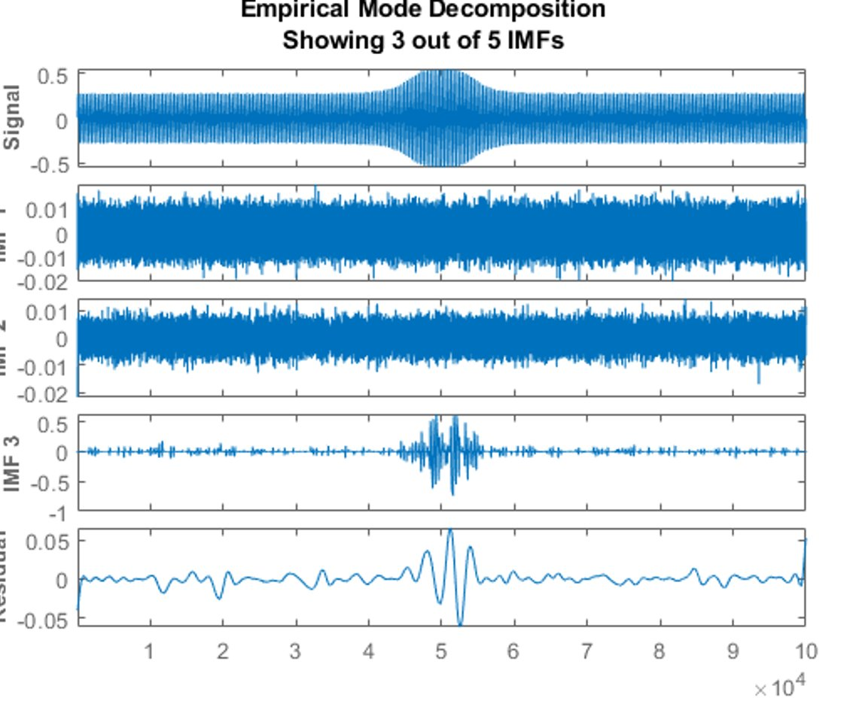
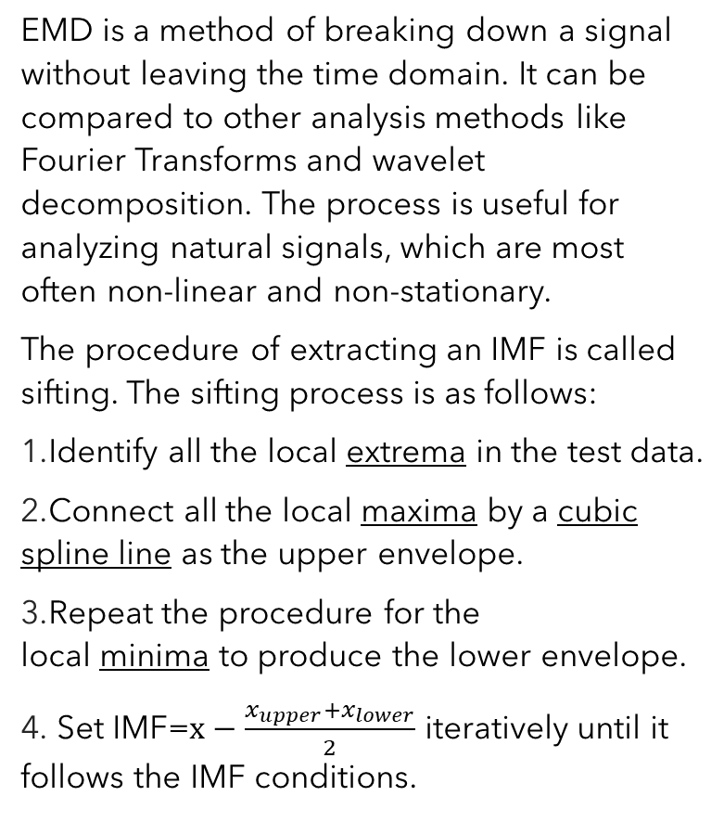
Empirical Mode Decomposition
EMD is a method of breaking down a signal without leaving the time domain. It can be compared to other analysis methods like Fourier Transforms and wavelet decomposition. The process is useful for analyzing natural signals, which are most often non-linear and non-stationary.
The procedure of extracting an IMF is called sifting. The sifting process is as follows:
Identify all the local extrema in the test data.
Connect all the local maxima by a cubic spline line as the upper envelope.
Repeat the procedure for the local minima to produce the lower envelope.
Set IMF=$x−\frac{x_{upper}+x_{lower}}{2}$ iteratively until it follows the IMF conditions.

Slide 11
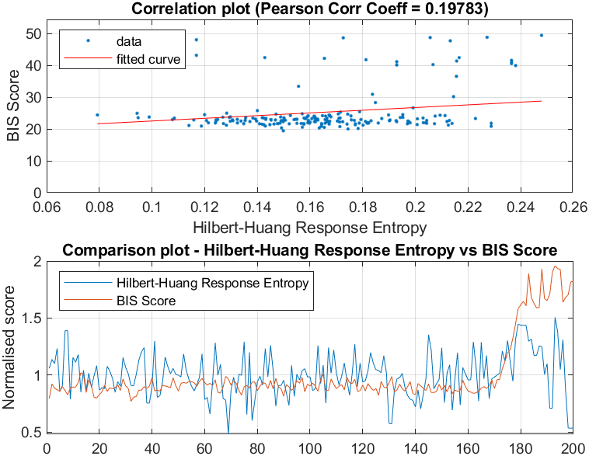
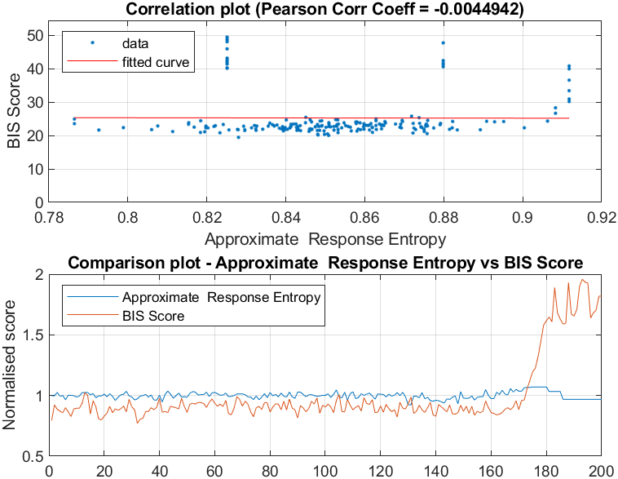
Results

Slide 12
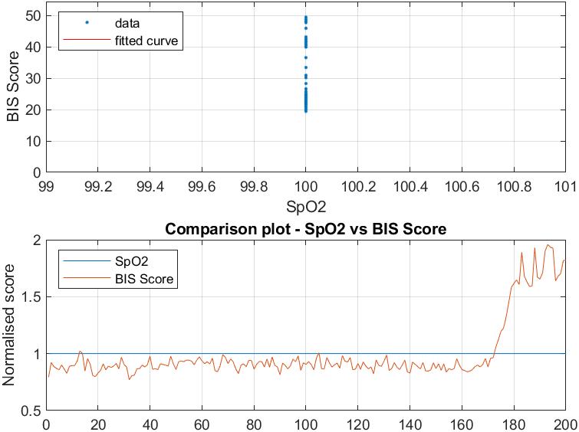
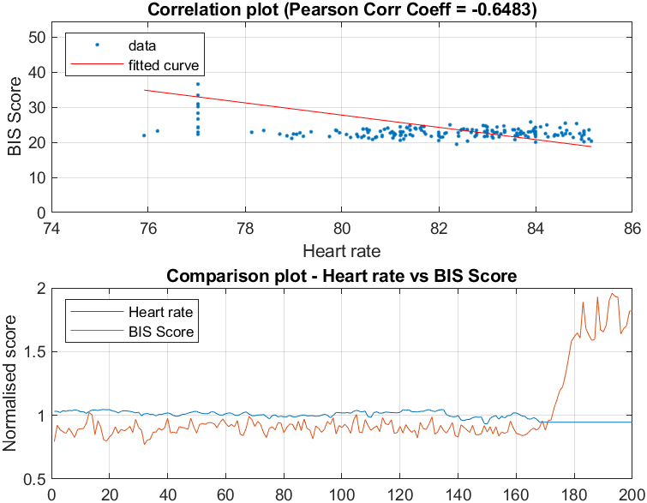
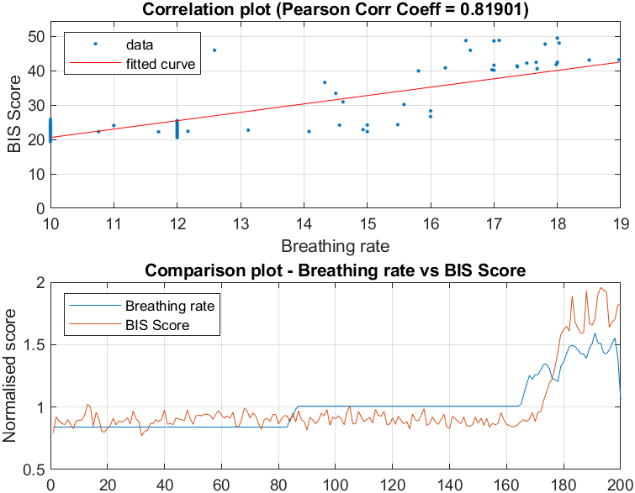
Biological Vitals

Slide 13
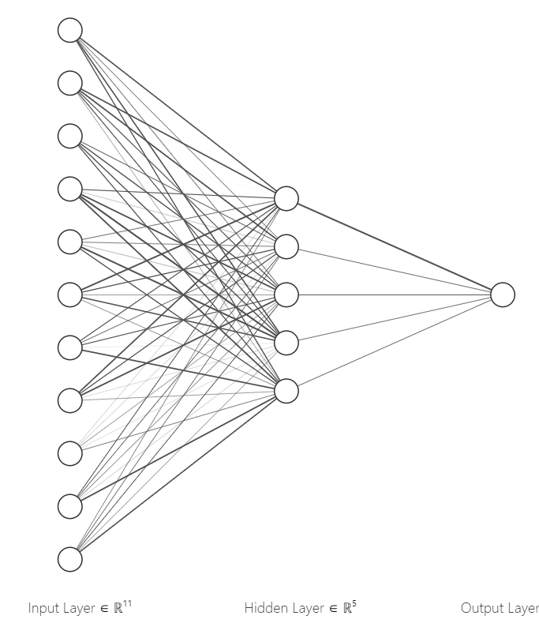
On To The Neural Network
Artificial Neural Networks derive inspiration from Biological Neurons
The regression problem: We have a set of inputs; now we need a model to recognise the pattern, i.e how the different parameters combine to give one final score.
We turn to neural networks, the most adaptable way of solving a learning problem
Our Input Data: About 1000 samples of 11 parameters: Two HH Entropy values, two approximate entropy values, alpha wave power, delta wave power, delta ratio and our body vitals – heart rate, respiratory rate and blood oxygen saturation. Our Output: Degree of Anaesthesia We mark the last 200 points as test data and the remaining as training data
Using PyTorch, we define the layers, how they link together and the non-linear activation functions within the hidden layers of the neural network
The first layer neural network is regularised strongly to prevent overfit of data

Slide 14
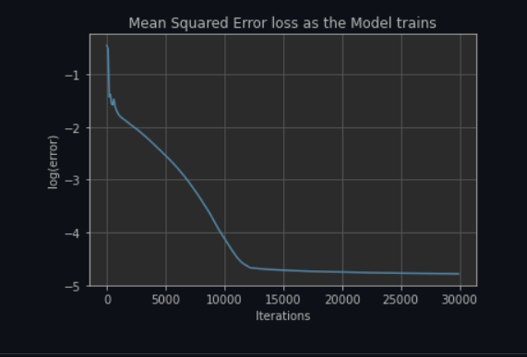
Training the Neural Net
We've taken the learning rate = 0.01, and number of epochs = 30000. (Epoch is the number of times the “learning” happens for the entire data set). We have use Stochastic Gradient descent on the training dataset for backpropagation.
In addition we have regularized the weights of the first layer with an L1 regulariser, because we want a sparse solution. i.e only really useful metrics get considered. This prevents overfitting, especially when there are lesser number of points like ours.
While training, increasing the number of iterations i.e., the number of passes that we make, we see that the mean squared error drops.

Slide 15
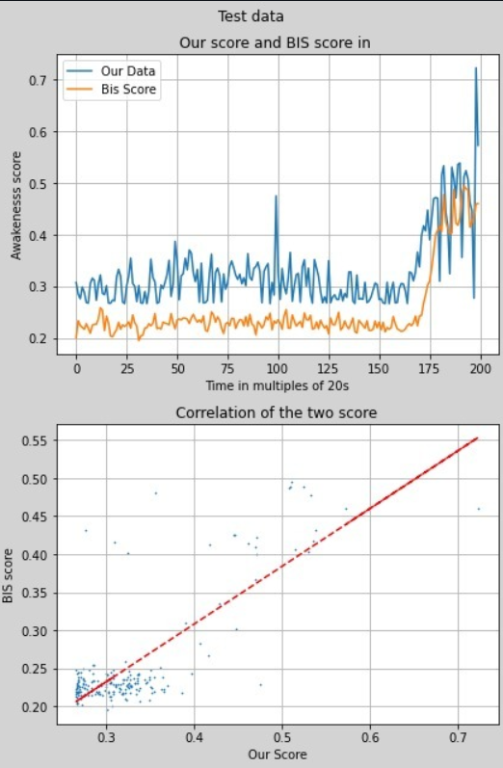
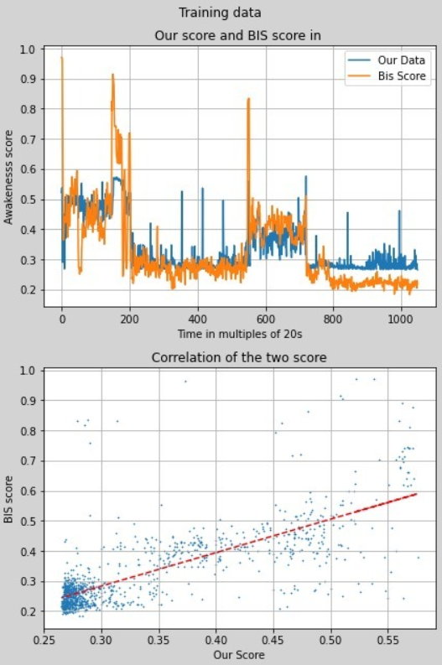
Results From The Neural Network
The data plotted to the right represent the training and the testing accuracy.
We get a training accuracy of 75.4% and a testing accuracy of 78.6%
The model generalizes well because of regularization.
The result we get from the neural network is a value ranging from 0 to 1 indicating the Degree of Anaesthesia.
We see that the test data is positively correlated, with some error of prediction (predicts a lower value).

Slide 16
In Conclusion,
We've successfully preprocessing the Signal along with calculating Hilbert Huang Entropies and performing Power Spectral Analysis. The results from our neural net regression model were pretty amazing.
ECG Removal through Independent Component Analysis and Burst Suppression Ratio was something we couldn't implement within the given time. We’d like to implement our approach on a recurrent neural network and on a larger dataset.
Despite the lack of enough datapoints, we've achieved an accuracy of 78.6% using the simplest neural network
Don't overdose on Anaesthesia!

Slide 17
Thank You!

